Slide 1

I/O STREAM IN C++

Slide 2
C ++ Stream
Stream is an interface used between program and device files.
A stream is a sequence of bytes.
Types:
Input Stream :-
The source stream that provides data to the program from input device.
Input device→Input stream→Program
Output Stream :-
The destination stream that receives output from the program.
Program→Output stream→Output device

Slide 3
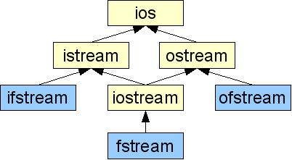
I/O Stream

Slide 4
stream - a sequence of characters
Interactive (iostream)
contains basic information required for all stream I/O operations
cin - input stream associated with keyboard.
cout - output stream associated with display.
file (fstream)
contains information for performing file I/O operations
ifstream - defines new input stream (normally associated with a file).
ofstream - defines new output stream (normally associated with a file).

Slide 5
Unformatted I/O Operations Overloaded Operators >> and <<
The objects cin and cout are used for input and output of data of various types.
By overloading the operators >> and <<.
>> operator is overloaded in the istream class.
<< operator is overloaded in the ostream class.
This is used for input data through keyboard.

Slide 6
File Modes
File mode specifies the purpose for which the file is opened.
File mode parameters:
ios::app | //Append to end-of-file
ios::ate | //go to end-of-file on opening
ios::binary | //Binary file
ios::in | //open file for reading only
ios::nocreate | //open fails if the file does not exists.
ios::noreplace | //open fails if the file already exists.
ios::out | //open file for writing only
ios::trunc | //delete the contents of file if it exists

